Slide 1
WEEK 5 Using Non graphical Text Editors in Linux
GENERAL OBJECTIVES: Using non graphical Text editors in Linux
SPECIFIC OBJECTIVES: Mastery of VI/Vim and nano editors

Slide 2
Using non graphical Text editors in Linux
One of the key skills you will need when working with any Linux system is the ability to use a text editor effectively.
Why? Because most of the system configuration tasks you need to complete in Linux, whether you’re configuring the operating system itself or a service running on the system, are completed using a text editor and a text file.
This represents a significant difference between Linux and other operating systems, such as Windows.
Under Windows, most of your configuration settings are stored in a database called the Registry. This information is stored in logical sections called keys.
These keys are stored in a hierarchy; a given key can contain a number of subkeys. These keys contain values that store the system’s configuration information.

Slide 3
Using non graphical Text editors in Linux
The Registry is a good concept, but one of the key problems with it is that it isn’t designed with the end user in mind.
While a Registry editor named Regedit.exe is supplied with Windows, you are strongly discouraged from manually editing values in the Registry.
Instead, you’re supposed to let the operating system along with applications installed on the system make any and all changes to the Registry.

Slide 4
Using non graphical Text editors in Linux
Linux, on the other hand, doesn’t use a central repository of all system configuration information like the Windows Registry. Instead, all of your configuration information is stored in a variety of text files.
Most of these files are stored in the /etc directory in your Linux file system. For example, the text file used to configure the NTP service on your system (which is used to synchronize the system time with other network computers) is the /etc/ntp.conf file.
Instead of forbidding you from manually editing these configuration files, as Windows does with the Registry, Linux expects you to know how to edit these files to customize the way your system runs.
Therefore, you must know how to use Linux text editors to manage your system.

Slide 5
Using the vi/vim Editor - Basics
The vi editor is a very basic program that can be used to edit text files on a Linux system.
The vi editor has been around for quite some time and it is one of the more widely used text editors used by Linux administrators.
There are actually two versions of vi. The older version is called simply vi. The newer version is called vim (Vi IMproved).
On older systems, you may be actually using vi when you enter vi at a shell prompt. However, on most newer Linux distributions, you are probably actually using the newer vim version of vi.

Slide 6
Opening Files in vi
To open a file from the shell prompt to manipulate in vi, simply enter vi file name. If the file resides in a directory other than the current directory, you then need to include the full path to the file.
For example, suppose your current directory is /tmp and you need to open the /var/log/messages file in vi. To do this, you would enter vi /var/log/messages at the shell prompt.
It’s also possible to create a new text file using vi. To do this, simply enter vi followed by the name of the file you wish to create at the shell prompt. That is vi myfile
If you don’t include a path with the file name, then the file will be created in the current directory. If you specify a path, then the file will be created in that directory.

Slide 7
Vi Modes
Vi uses four different operating modes:
■ Normal mode ■ Insert mode
■ Command mode ■ Replace mode
By default, vi opens or creates a file in normal mode
However, while in command or normal mode, you can’t actually edit the file!
To edit the file you have to get to insert mode press any one of the following keys on the keyboard:
■ INSERT
■ I
■ S

Slide 8
Vi Modes
After pressing one of these keys, you can then actually edit the text of the file.
You can tell you’re in insert mode by the --INSERT-- text displayed at the bottom of the vi interface.
Insert mode is analogous to using a word processor in insert mode.
Any text you type is inserted wherever the cursor is located in the file.
All text that may already exist after the cursor is moved down a space for each character typed.

Slide 9
Vi Modes
Replace mode, on the other hand, is analogous to overtype mode. When you type in new characters, the new characters overwrite any existing characters. You can toggle back to insert mode by pressing INSERT again.
While in insert mode, you can add text, change text, or delete text from the file. However, you can’t perform any file operations.
For example, if you make changes to a file and want to save them, you can’t do so while in insert mode. To do this, you must first switch back to normal mode. This is done by pressing ESC.

Slide 10
Working in Insert Mode
Once you have opened a file in vi and entered insert mode, you can edit the text as you would with any other text editor.
Note that, on the left side of the screen, you see several lines of tildes (~). These characters aren’t actually in the file. These characters simply indicate that these lines don’t exist in the file. After adding lines to the file, you’ll see that the tildes disappear one at a time.
You can navigate around to different insertion points in the file by pressing the arrow keys as well as the PAGE UP, PAGE DOWN, HOME and END keys.
You can add text by simply typing characters on the keyboard. You can remove text by pressing DELETE.
However be warned that you cannot use the backspace key!

Slide 11
Using the Command & Normal Mode in Vi
To enter command mode in vi, you must first enter normal mode (if you were previously in insert mode) and then enter a colon (:). When you do, a command prompt is displayed at the bottom of the screen.
You can then enter commands at this prompt to accomplish file-related tasks.
Obviously, one of the most important tasks you’ll need to complete in command mode is to write the file to disk.
This is done by entering w at the command prompt.
Be sure to press ENTER after entering the command.
After entering w at the command prompt, a message is displayed at the bottom of the screen indicating that the file has been written to disk

Slide 12
Entering w file_name at the command prompt will write the file to a different file name. You can also enter the following other commands at the command prompt:
■ exit Writes the current file and then closes vi.
■ wq Also writes the current file to disk and closes vi.
■ q Closes vi without saving the current file. This can only be used if the file hasn’t been changed. If the file has been changed, then you must enter q!.

Slide 13
Using the Command & Normal Mode in Vi
Normal mode commands aren’t entered at the command prompt, as the preceding commands were. Instead, these commands are entered without entering a : first. If you are in insert mode, press ESC to return to normal mode. Then you can enter the following commands:
■ dw Deletes the word that comes immediately after the cursor, including the space following the word. The text is saved in a memory buffer.
■ de Deletes the word that comes immediately after the cursor, not including the space. The text is saved in a memory buffer.
■ d$􀀀 Deletes from the insertion point to the end of the line. The text is saved in a memory buffer.
■ dd Deletes the entire current line. The text is saved in a memory buffer.

Slide 14
Entering Commands in vi Normal Mode
■ p Inserts the text deleted in the last deletion operation after the current cursor location.
■ u Undoes the last action.
■ CTRL-G Displays a status line at the bottom of the interface. This displays the name of the file, the total number of lines in the file, and the current cursor location.
■ /search_term Searches for the next instance of the term specified. For example, entering /init searches for the next instance of the text “init” after the cursor.

Slide 15
Using the vi Editor[Exercise]
In this exercise, you will practice using the vi editor to create and manipulate text files. Complete the following:
1. If not already done, boot your Linux system and log in using your standard (non-root) user account.
2. Open a terminal session. The session should open with your user’s home directory as the current directory. You can check this by entering pwd at the shell prompt. If your user account is named tux, then the current directory should be displayed as /home/tux.
3. At the shell prompt enter vi test.txt. The vi editor should run with test.txt open as a new file.
4. Press the INSERT key on your keyboard. You should now be in insert mode
5. Enter the following text in the file:
This course will focus on practical issues in Linux System Administration to provide students with skills and capabilities to work as a system administrators. Topics treated include: deployment and installation, general system-user and group administration, basic Linux commands, booting up and shutting down, software management. Process control and Management.

Slide 16
6. Save your file by completing the following:
a. Press ESC to return to normal mode.
b. Enter :w. You should see a message indicating that the file was written.
7. Exit vi by entering :exit.
8. Reload test.txt in vi by entering vi test.txt at the shell prompt.
9. Display the status line by pressing CTRL G while in normal mode.
10. Use the arrow keys to move the cursor to the beginning of the first word in the first line of the file.
11. Search for all occurrences of the text “mini” by completing the following:
a. While in normal mode, enter /mini. The first instance should be highlighted.
b. Find the next instance by pressing the N key.
c. Find the remaining instance by pressing N until you reach the end of the file.

Slide 17
Using the vi Editor
12. Practice deleting text by doing the following:
a. While in normal mode, use the arrow keys to place the cursor on the first letter of the word system.
b. Delete the word system and the space that follows it by pressing dw
c. Use the arrow keys to move the cursor to the period at the end of the last line.
d. Put the contents of the memory buffer after the period by entering p.
13. Exit the file without saving your changes by entering :q!.
You now have sufficient skills to use vi to manage a typical Linux system!

Slide 18
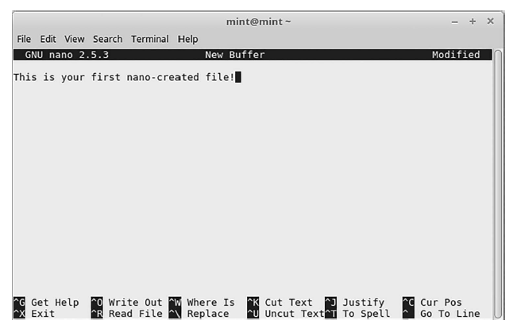
Using nano Editor
The simplest and most readily available text editor in all of the Linux systems is nano.
Creating and Opening a New File
To create a new file and open it using nano, use the following command(s):
$ nano
or
$ nano [file name]—for an existing file with file name
If you want to open a file that is not located in your current directory, then you have to use the absoluteor relative path to that file.
For example, /home/mint/filename

Slide 19
How to save a File
To save a file, use the keyboard shortcut <Ctrl+O>.
When you use this key combination, the editor will prompt you for a filename (or confirm the name if it was already provided when the editor was started).
Enter your filename and press <Enter> to save the file with that name

Slide 20
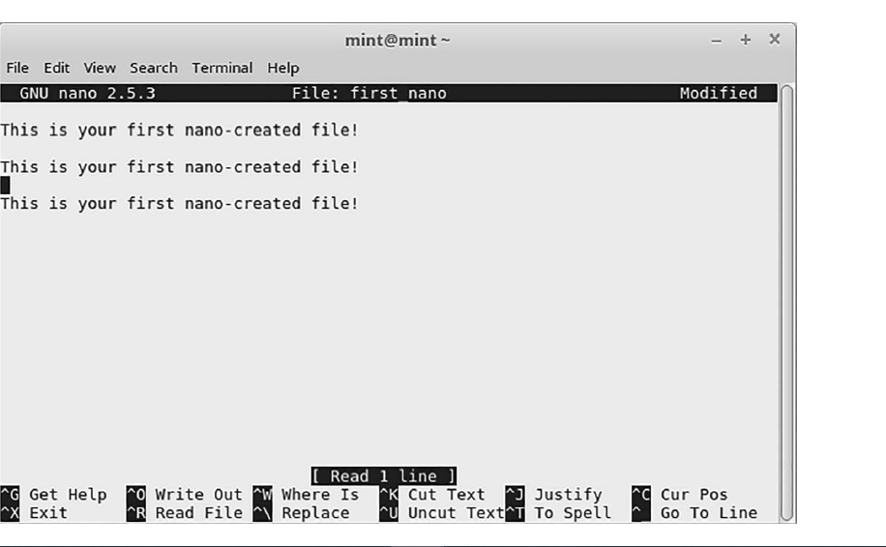
How to Cut and Paste Text
To cut and paste a particular line of existing text that has already been entered into the buffer, first bring the cursor to any character on that line by using the arrow keys on the keyboard. Press <Ctrl+K> to cut that whole line out of the buffer, then position the cursor with the arrow keys to the place where you want to paste the “cut” line back into the buffer, use <Ctrl+U> to paste the cut line back in.

Slide 21
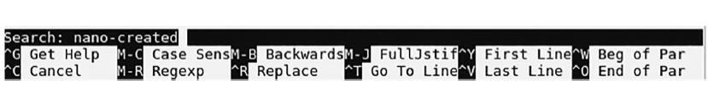
How to Search and Replace a Word
This feature allows you to search for a particular word in the buffer, as well as replace it with another word.To search for a word in nano, press <Ctrl+W>. Then, you will be asked to enter the word which you want to search for. After typing in the word, press <Enter> and the tool will take you to the matched entry

Slide 22

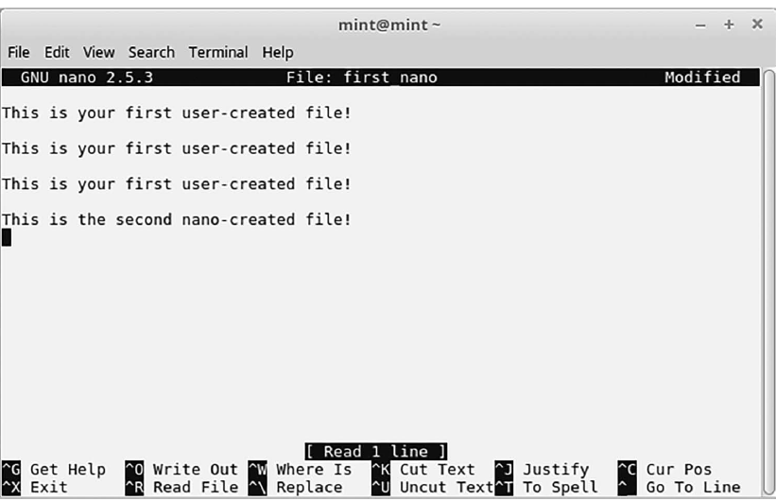
How to Insert Another File into the Current One
To insert text from another, already-saved file, into the buffer you are currently editing, do the following. Press <Ctrl+R>, and then give the complete pathname to the file which you want to insert into the current buffer, at the current position of the cursor in that buffer.

Slide 23
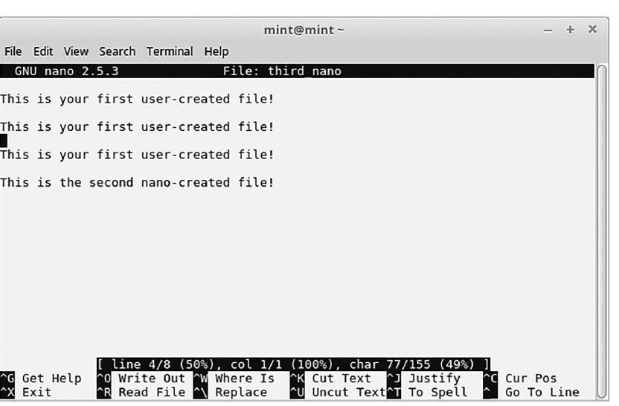
How to Show the Cursor Position
It is possible to get information about the position of your cursor in the current buffer. This can be done
by pressing the <Ctrl+C> keyboard shortcut. After <Ctrl+C> was pressed, the cursor position got highlighted in the editor
area, and detailed information about it showed up in the status line

Slide 24
How to Back Up a Previous Version of a File
This facility allows you to back up the previous version of the file being edited. This is done after you make changes and save the file. This feature can be accessed using the -B command line option
$ nano -B [file name]
For example: $ nano –B myfile
The backup will be saved in the current directory with the same filename but suffixed with a tilde (-B).
Noe: Files created for the first time cannot be backed up.

Slide 25
Self test Exercises
﻿1. Where are operating system and application configuration parameters stored on a Linux system?
A. In text files
B. In the Registry
C. In .ini files
D. In the system database

Slide 26
Self Test Exercises
2. Where are most configuration files stored in the Linux file system?
A. /boot
B. /var
C. /usr
D. /etc
3. Where can you find the vi symbolic link file on most Linux distributions?
A. /usr/bin
B. /boot
C. /etc
D. /var/vi

Slide 27
Self Test Exercises
4. Which of the following is an advantage of the vi editor?
A. It provides a syntax checker.
B. It provides a menu-driven user interface.
C. It is small enough to fit on a floppy.
D. It can be used to edit Microsoft Word files.
5. You have a terminal window open and the current directory is /tmp. You need to use vi to
open a file named vnc in the /etc/xinetd.d directory on your system. Which of the following
commands will do this?
A. vi vnc
B. vi /tmp/vnc
C. vi /etc/xinetd.d/vnc
D. vi /etc/xinetd.d

Slide 28
Practice Questions
Run nano on your Linux system. Create and edit a block of text that you want to be the body of an e-mail message explaining the basic capabilities of the nano editor. This file should be at least one page (45–50 lines of text) long. Then, save the file as nano_doc.txt. Insert the body of text you created in an e-mail message and send it to yourself.
2. Log on to your Linux system, and execute the nano program on a new, blank file. On the first line of the file, type your first and last name. On the second line of the file, type “The nano Linux text editor allows you to do simple editing on small text files efficiently.”
Use a nano command to write the file to the default directory with the name lab51.
3

Slide 29
3.
Do the following steps to create a file in nano-
Step 1: At the shell prompt, type nano and then press <Enter>.
Step 2: In the text area of the nano screen, place the cursor on the first line and type-
This is text that I have entered on a line in the nano editor.
Use the <Delete> and <arrow> keys to correct any typing errors you make.
Step 3: Press <Enter > three times.
Step 4: Type-
This is a line of text three lines down from the first line.
Step 5: Hold down the <Ctrl> and <O> keys at the same time (<Ctrl-O> or <^O>).
Step 6: At the prompt File Name to Write: type linespaced and then press <Enter>.
Step 7: Hold down the <Ctrl> and <X> keys at the same time (<Ctrl-X> or <X>) to return to
the shell prompt.
Step 8: At the shell prompt, type more linespaced and then press <Enter>.

Slide 30
4.Do the following steps in nano:
Step 1: At the shell prompt, type nano linespaced and then press <Enter>. The linespaced file
you created in Problem 4 appears in the nano screen.
Step 2: Position the cursor at the beginning of the fourth line, at the character T in the word
This, using the <arrow> keys on the keyboard.
Step 3: Hold down the <Ctrl> and both the <Shift> and <6> keys at the same time.
Step 4: Move the cursor with the <right arrow> key on the keyboard until you have highlighted
the entire fourth line, including the period. The cursor should be one character to the right
of the period at the end of the line.
Step 5: Hold down the <Ctrl> and <K> keys at the same time. This action cuts the line of text
out of the current “buffer,” or file that you are working on.
Step 6: Position the cursor with the <arrow> keys at the beginning of the second line of the file,
directly under the line that reads
This is text that I have entered on a line in the nano editor.
Step 7: Hold down the <Ctrl> and <U> keys at the same time. This action pastes the former
fourth line into the second line of the file.

Slide 31
Step 8: Use the <arrow> keys on the keyboard to position the cursor at the third line of the file.
Step 9: Hold down the <Ctrl> and <U> keys on the keyboard at the same time. This action
pastes the former fourth line into the third line of the file.
Step 10: Now change the wording of lines 2 and 3 so that they read-
This is a line of text 1 line down from the first line.
This is a line of text 2 lines down from the first line.
How many lines are there in this file now, as far as nano is concerned?
Step 11: Hold down the <Ctrl> and <O> keys at the same time.
Step 12: At the prompt File Name to Write: type linespaced2 and then press <Enter>.
Step 13: Hold down the <Ctrl> and <X> keys at the same time to return to the shell prompt.
Step 14: At the shell prompt, type more linespaced2 and then press <Enter>.
What do you see on screen? How many line does the more command show in this file?

Slide 32
END OF SLIDES

